Slide 1
Presentation Project
Bjorn Jorissen
William Thenaers

Slide 2
Our Idea
Complex rules ➔ use technology
Monopoly has rules that are often overlooked
Framework ➔ boardgames with linear pathway
Using RFID tags & LIDAR
Notes:
Embed a boardgame with somewhat complex rules with technology to decrease the knowledge needed to play this game.
We used monopoly as an example, we played it online once and there are a lot of rules that I never used while playing with the physical boardgame that made the game more interesting imo.
Our goal was to make a framework that can be used in all boardgames with a similar style. Right now it could be used with all boardgames which have a linear pathway.
This framework would combine RFID tags to determine which piece had moved and LIDAR to determine where it moved to. This changed during our research and experiments.

Slide 3
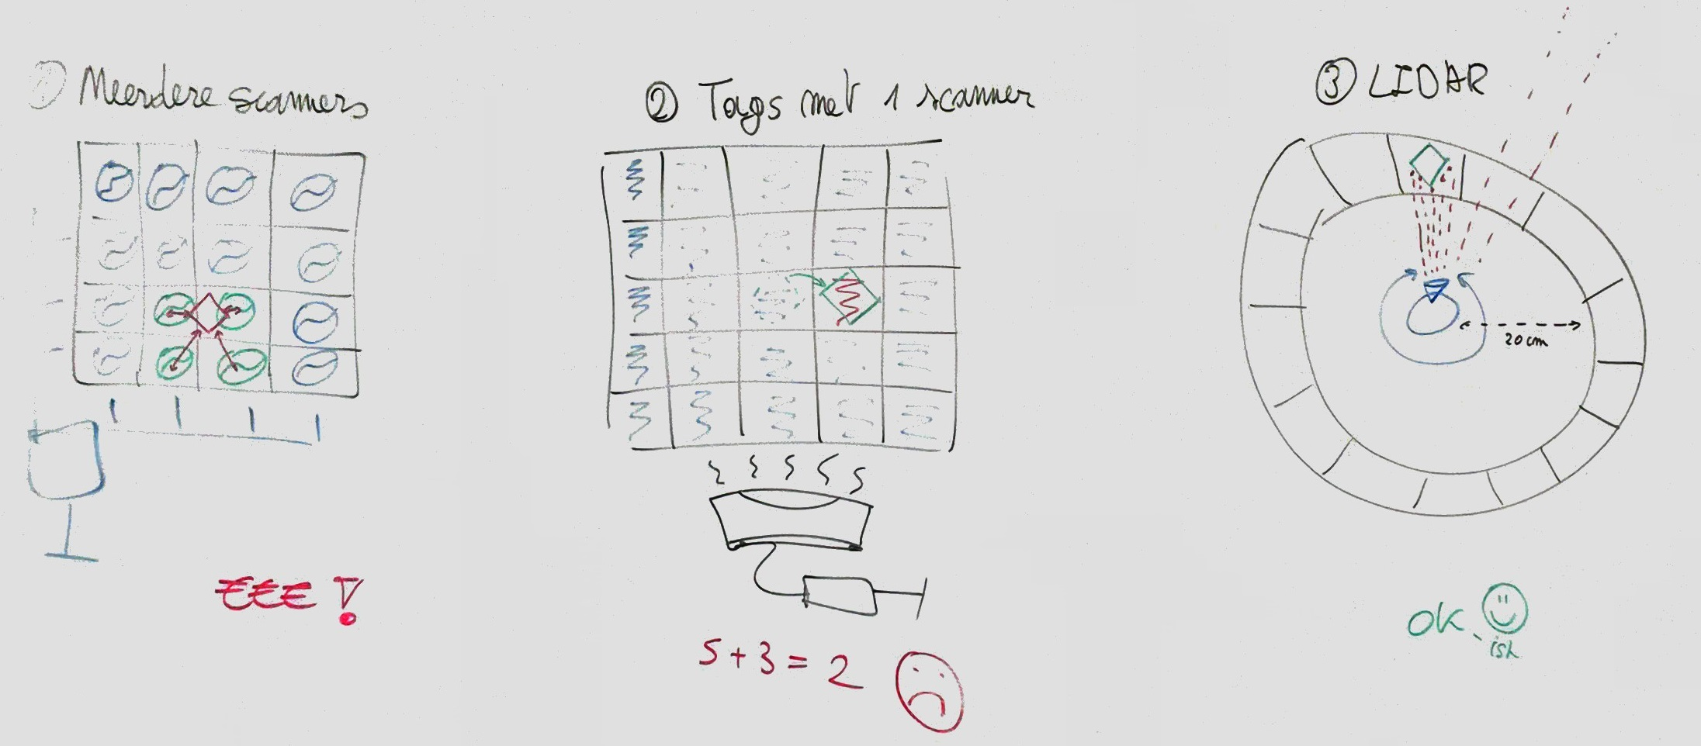

Slide 4
Idea: multiple scanners
Feedback: to expensive
Every scanner ➔ an Arduino
Simultaneous RFID reader available
Notes:
Our first idea was to work with multiple scanners and RFID tags on every piece of the board game. With this we could make an triangular calculation with the signal strength of each RFID tag to determine the location.
In our feedback of this idea we understood that you would need an Arduino with a reader for every single scanner which would turn out to be too expensive.
Then you also said that an simultaneous RFID reader is available here at EDM. This reader should be able to read multiple tags at once.

Slide 5
Test the available simultaneous RFID reader
Notes:
So the next thing we needed to do was test the available RFID reader that could read multiple tags simultaneously, according to the spec sheets this reader is able to read 100 tags at once.

Slide 6
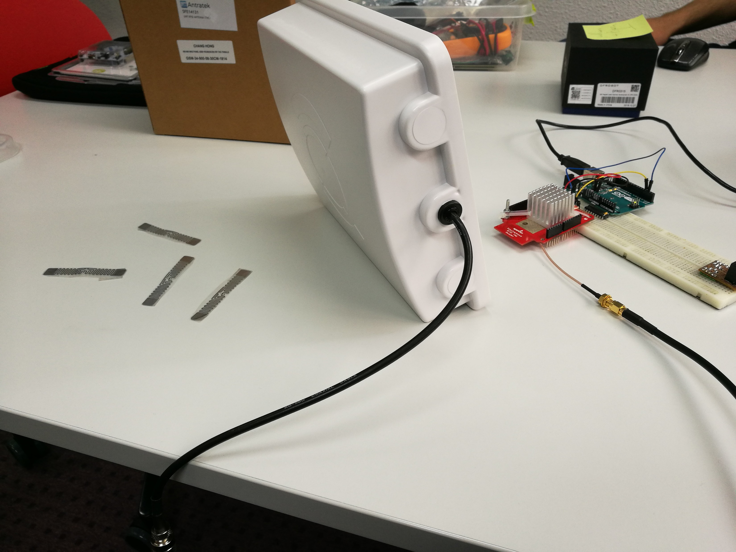
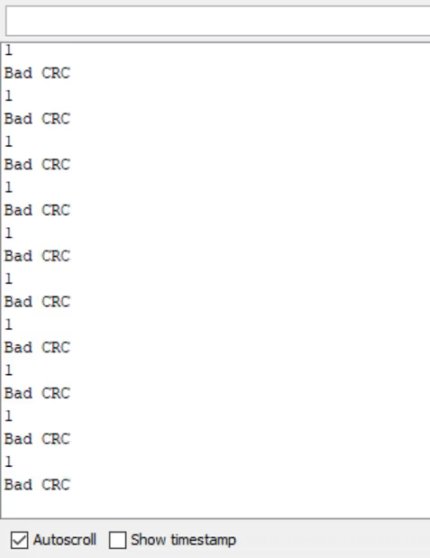
Notes:
Even with a very simple setup like this you get results like these. Bad CRC shows that the received signal is not reliable enough to ensure a correct received value. Like you can see most of the time only 2 different tags are detected, with the addition of tags in front of the reader this doesn’t increase, it makes it even worst sometimes.

Slide 7
Test the available simultaneous RFID reader
Way to unreliable for a simple setup
Interference of UHF tags and receivers
Power supply
In and out of range
Notes:
So this test resulted that the RFID reader is way to unreliable for even a simple setup so let alone a board filled with even more tags.
We did some research why this was the case because the reviews of the reader are good and a lot of people have shown a working example. The tags are Ultra-High Frequency tags, so these should avoid interference with other tags according to our research.
During this research we saw that the examples had an external power supply so we tried adding a power supply as well. But the results were not better than before we attached the power supply.
We also noticed that the examples had completely different use cases which only required to read each tag once. So we tried putting the tags out of the scanners range and back in the scanners range. This resulted in way better output, even just moving the tags results in better output. An RFID tag draws energy from Radio Frequency waves, we think that if these stay stationary this energy may be insufficient for the RFID tag to sent a reliable and complete signal. In all use cases for RFID the tags are moving, like using RFID tags to track inventory items from a warehouse.

Slide 8
[Moving tags & output video]

Slide 9
Velodyne LIDAR
Notes:
While working on the RFID tags we also experimented with the LIDAR.

Slide 10
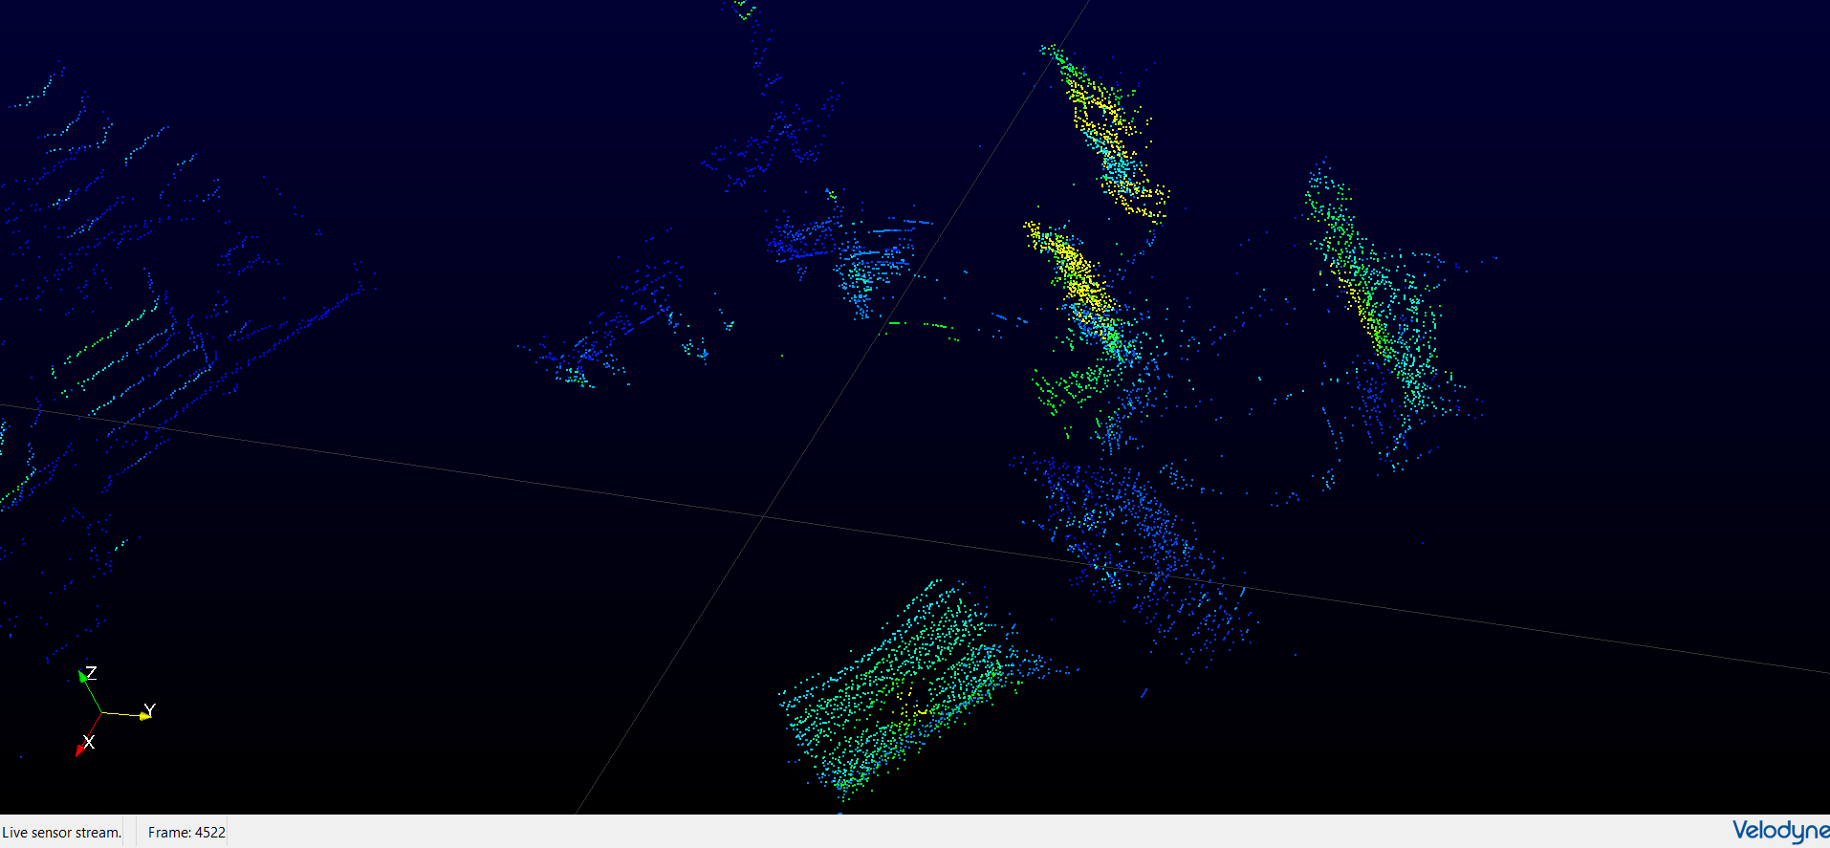
Maybe insert that video here, can’t find it though
Notes:
We started experimenting with the Velodyne LIDAR which was available from EDM.

Slide 11

Velodyne LIDAR
0.9 meter > Range > 100 meter
Outdoors
RPLIDAR
20 centimeters > Range > 6 meter
Indoors
Notes:
The Velodyne LIDAR has a minimum range of 0.9 meters and a maximum range of 100 meters. This is good for outdoors, which the LIDAR is designed for, but not really for our idea. We could change our idea yes, but at this stage we still though to combine the RFID tags and the LIDAR on a single boardgame. So we looked into different LIDAR’s and found a cheaper developer edition with a minimum range of 20 centimeters. This one was ordered and delivered very quickly.

Slide 12
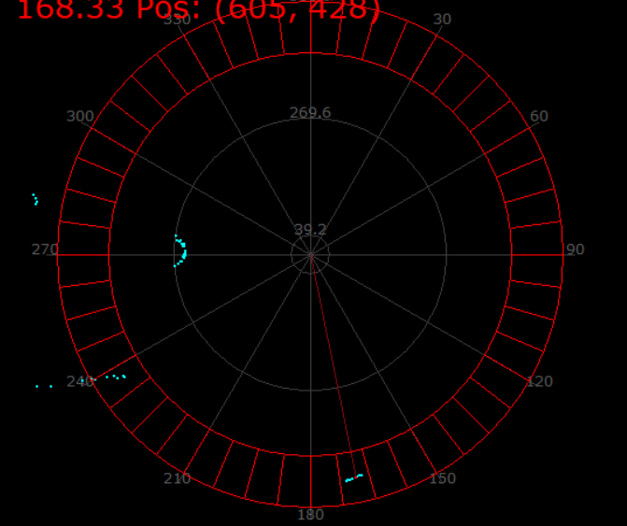
Amount of cells
Range of the cells
Determine which cells are occupied
Sent the new positions to the boardgame
Notes:
With the use of this LIDAR we made a program were you can set the amount of cells the boardgame has, the minimum range to the cells and the maximum range which is the distance from the LIDAR to the end of the cells. With this program we could determine which cells were occupied and pass this information to the game itself. From there we can then determine which cell position has moved (based on the previous received array).

Slide 13
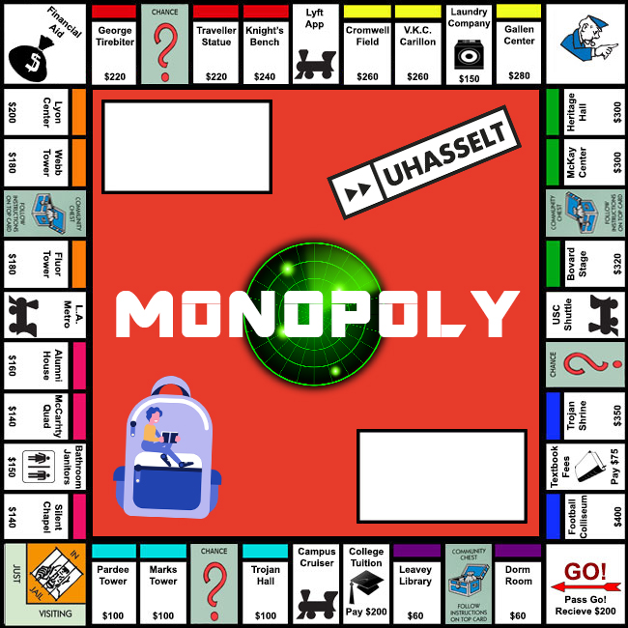
Not feature complete
Some of our additions
History
Visibility of pieces
Improvement in comfort
Visual changes
Bug fixes (lots of them)
Notes:
We then found and adjusted a open source monopoly game. It turns out that finding a feature complete monopoly game that is open source is not that easy. Our original goal for using technology to make the complex features easier is not achieved by this because only the simple features are implemented. To completely implement the game is kinda out of the scope of this project, the important part is using the LIDAR and plugging it into the game. If the game was feature complete we only needed to change the ‘rollDice’ function in order to make it work. Right now we even added a history function because we didn’t even knew what happened during a turn.

Slide 14
[Finished project pictures and stuff carton board, pieces & LIDAR]

Slide 15
Future work
Multiplayer
More games
Notes:
This gives the option to play on a physical boardgame to people all over the world. Off course the difficulty here would be checking if the player is not cheating, right now you could easily set your piece wherever you want and then the game will just assume your new position as your actual position.
Right now it’s not hard to plug the software we created for the lidar in any boardgame because all you need to do is set some parameters according to the board you printed or drew. We could make this process even easier by communicating through COM ports or something similar.

